Slide 1

Why we select this subject?

Slide 2
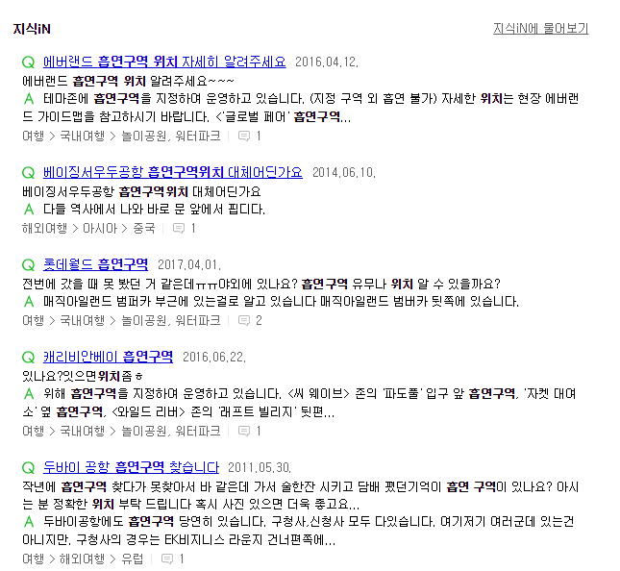
Why we select this subject?

Slide 3
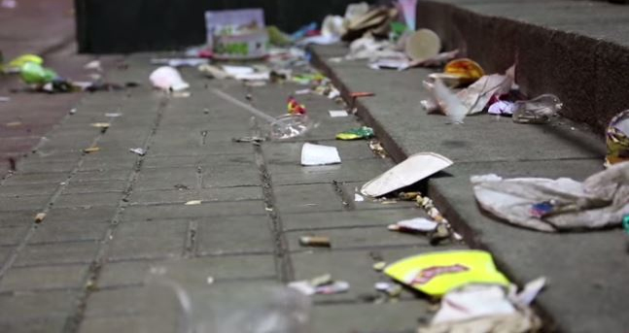
Why we select this subject?

Slide 4
Why we select this subject?

Slide 5

Why we select this subject?

Slide 6
What is our Difference?
 | USE-MAP | 여긴화장실 | Flush | 일본 화장실 어플
현재위치 주변 화장실 정보 | O | O | O | O
현재위치에서 바라보는 방향 | O | O | X | X
정보공개시스템 | O | O | O | O
사용자 업로드 기능 | O | X | X | O
시설 현황 평가 | O | X | O | O
정기 자동 업데이트 | O | X | X | X
장애인 화장실 유무 | O | X | X | X
범위 | 국내+국외 | 국내 | 국내 | 일본

Slide 7

What is our Difference?
2014.09.19 중앙일보 A8면 종이컵재떨이 등장
2014.07.30 NAVER 금주의 APP 선정
오마이뉴스/경기일보/머니투데이/머니위크/데일리그리드/ TV리포트/이데일리 등 각종 언론에 등장
종이컵 재떨이

Slide 8
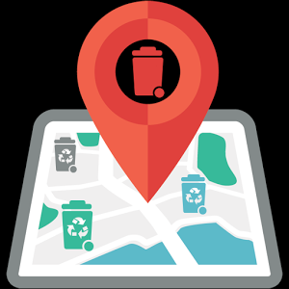
What is our Difference?
 | USE- MAP | 쓰레기통 찾기
사용자 추가 | O | X
공공 DB | O | O
시설 평가 | Review | Good & Bad
쓰레기통 찾기

Slide 9

What is our Limitations?

Slide 10

What is our Limitations?

Slide 11

What is our Characteristic?

Slide 12
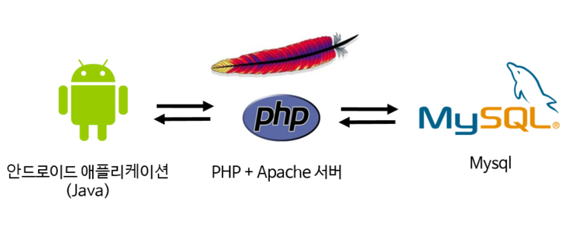


Slide 13
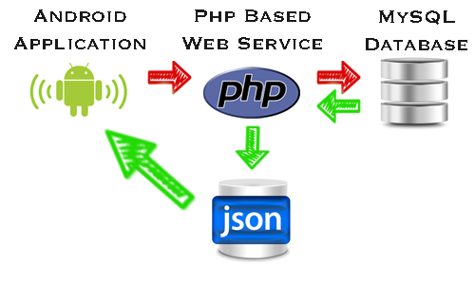
PHP → Android

Slide 14
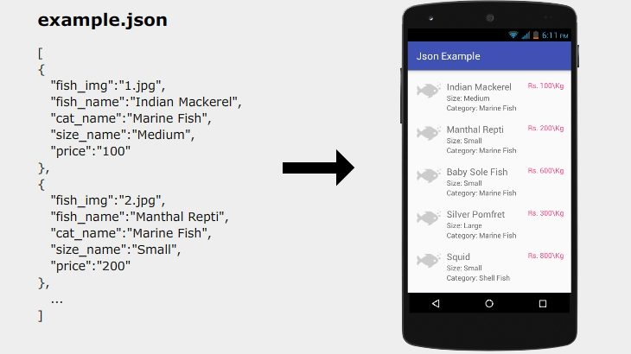
JSON Parsing

Slide 15
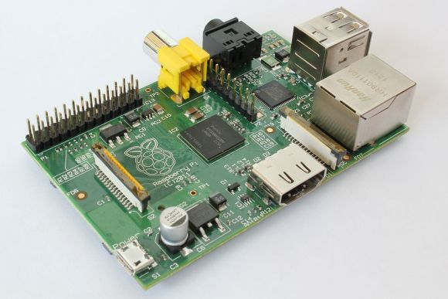
What is Raspberry Pi?
Tiny and affordable computer that you can use to learn programming through fun, practical projects.
Based on Linux operation

Slide 16
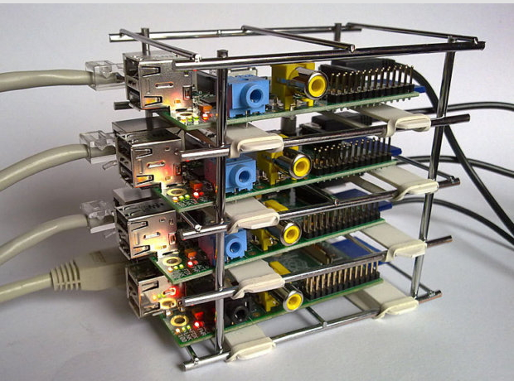
Raspberry Pi Server

Slide 17
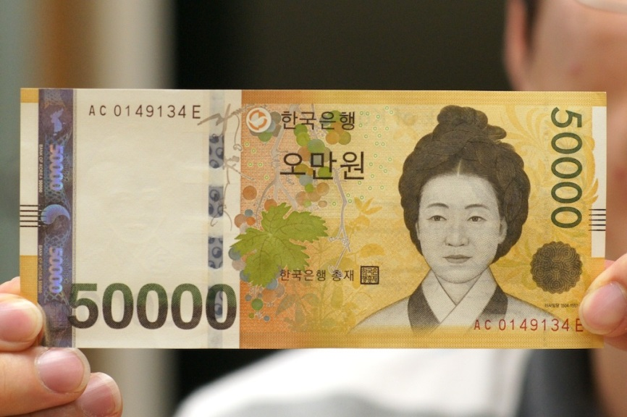

Why we use Raspberry Pi?
price

Slide 18

Why we use Raspberry Pi?
Low Cost

Slide 19
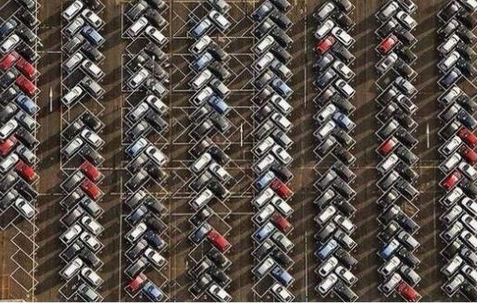
Why we use Raspberry Pi?
Space efficiency

Slide 20
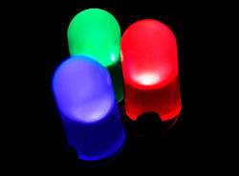
Why we use Raspberry Pi?
Intuitiveness

Slide 21
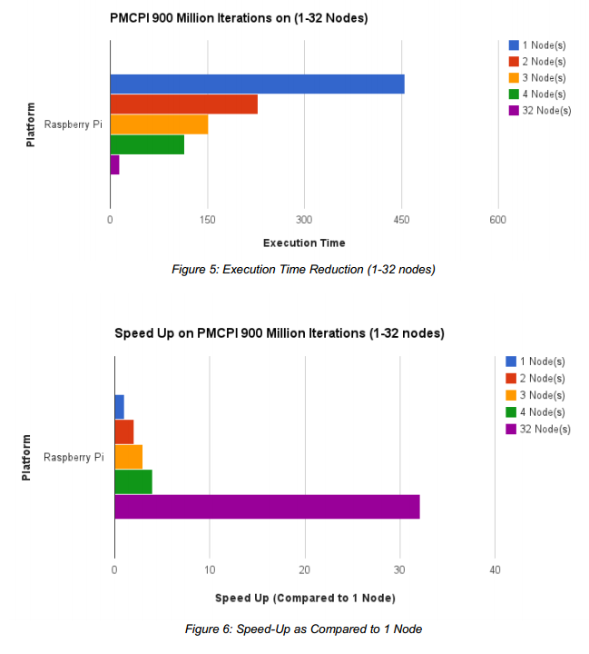
Why we use Clustering?
Speed-Up as Compared to 1 Node

Slide 22
Why we use Clustering?
Execution Time Reduction

Slide 23
Developed until now
USE MAP

Slide 24

Need to developed
Loading Screen

Slide 25
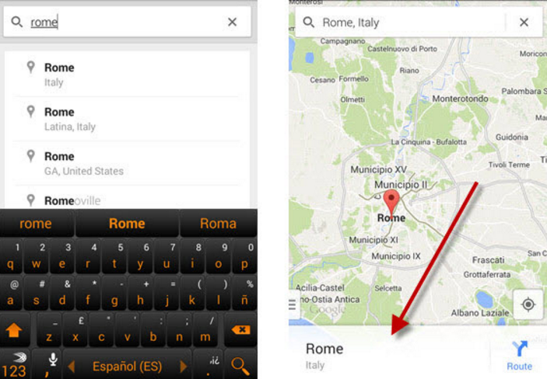
Need to developed
Search engine & Finding Path

Slide 26
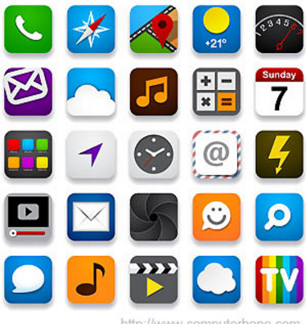
Need to developed
Resources should be changed

Slide 27
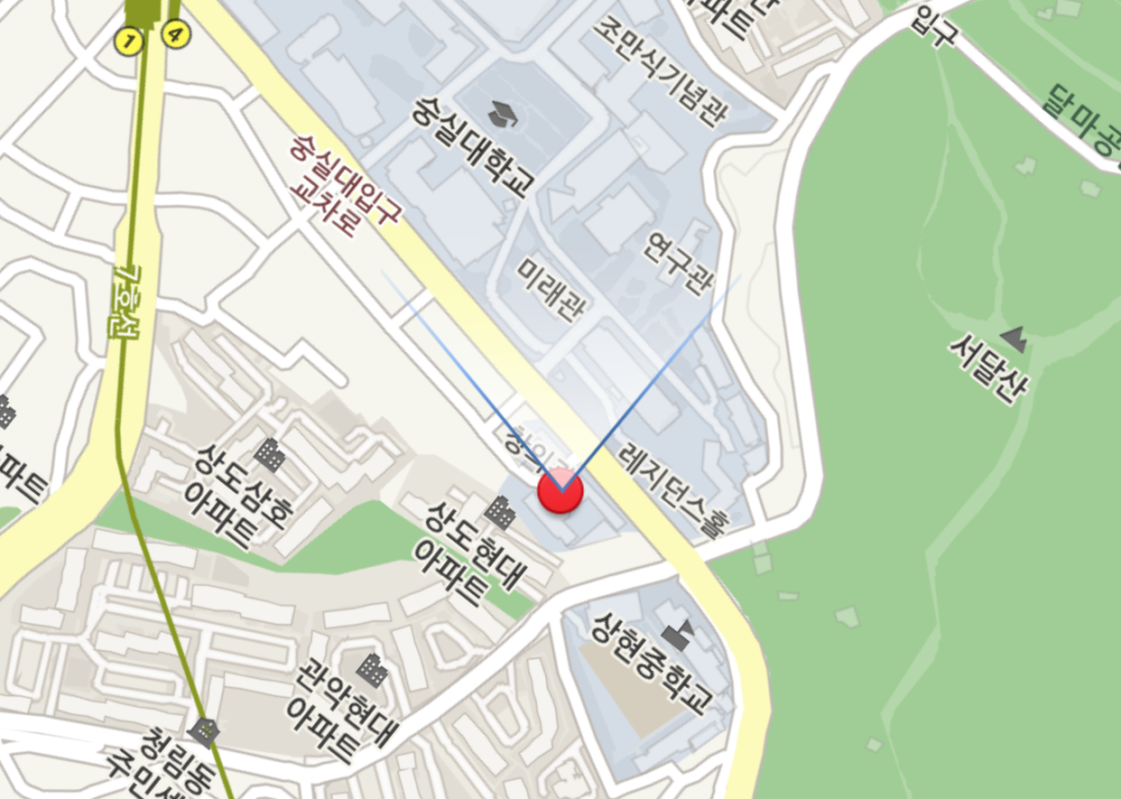
Need to developed
Rotation mark

Slide 28
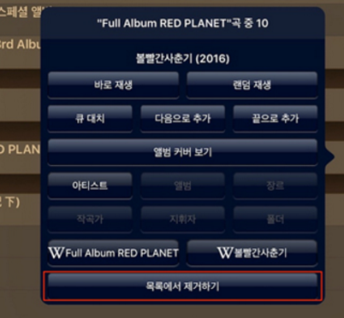
Need to developed
Adding data

Slide 29
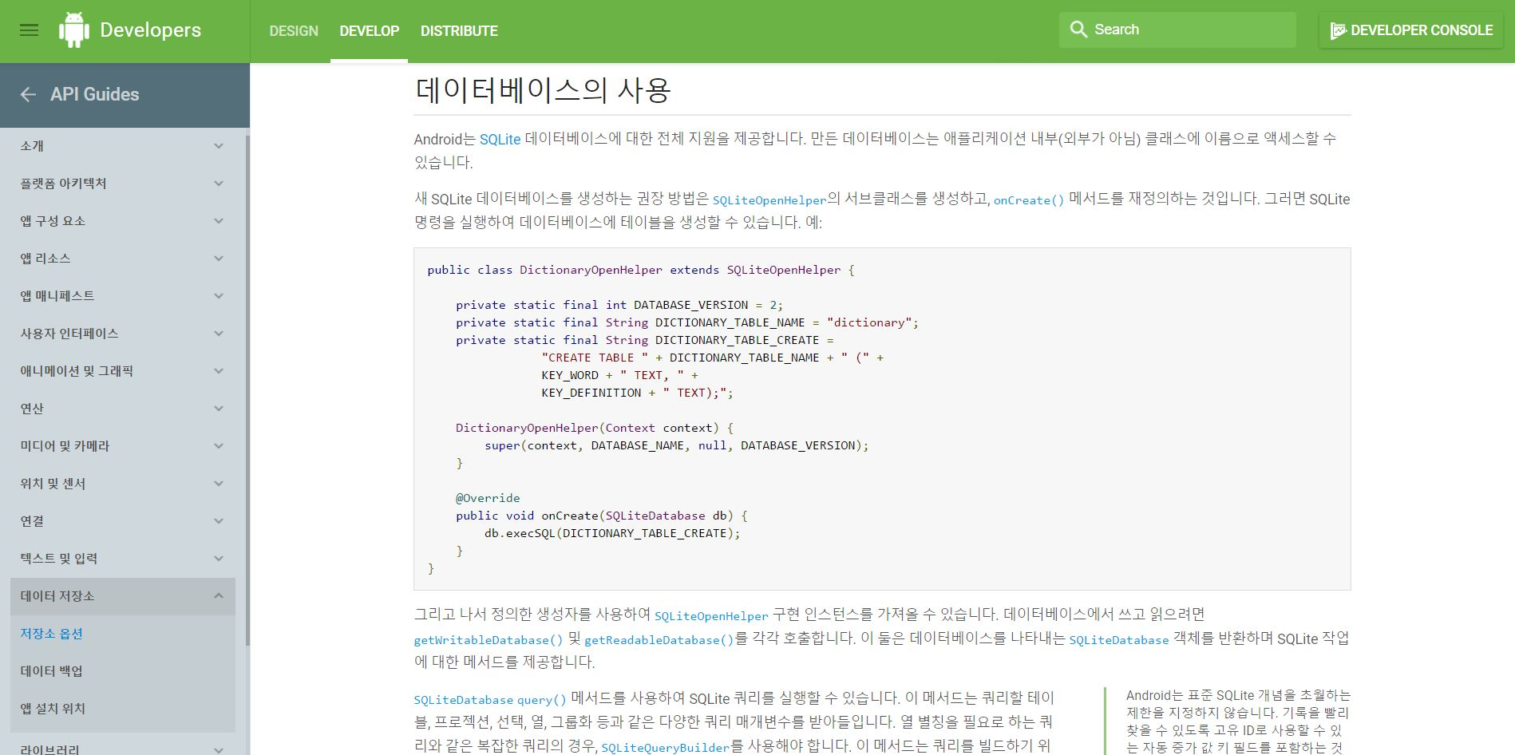

Need to Develop
SQLite3

